Slide 1






Romanesque Bridge
near Zwettl monastery

Slide 2
Romanesque bridge and chapel of st. John of Nepomuk
Josef Frank, 1960
StAZ BA-06.01.06.B.007

Slide 3
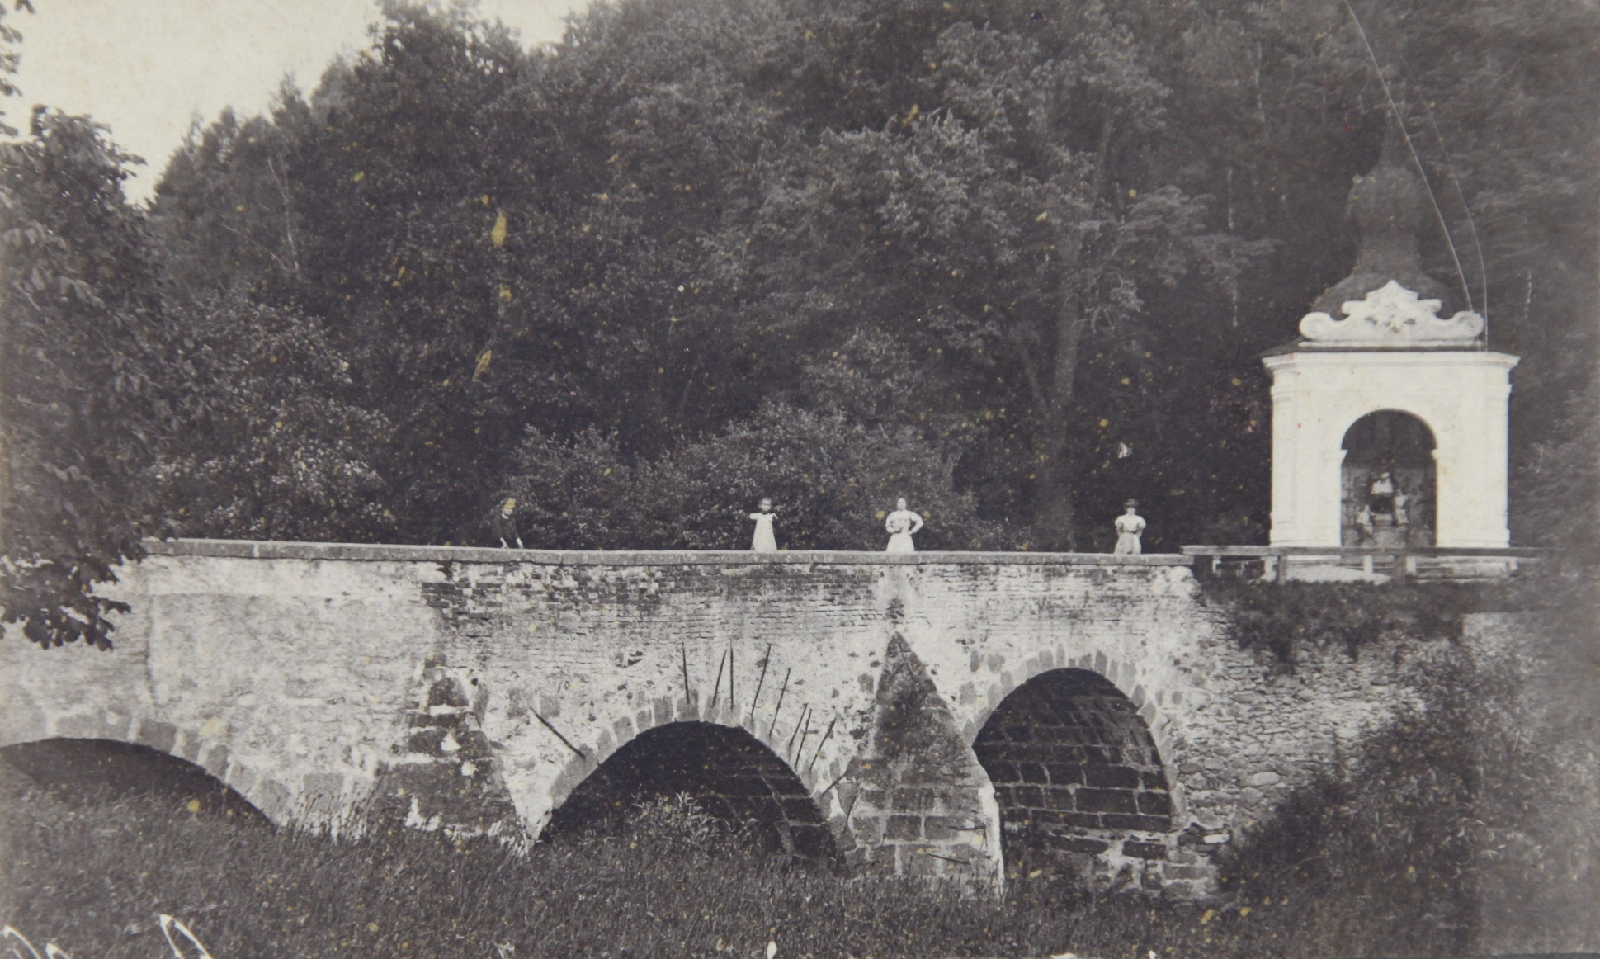

Slide 4
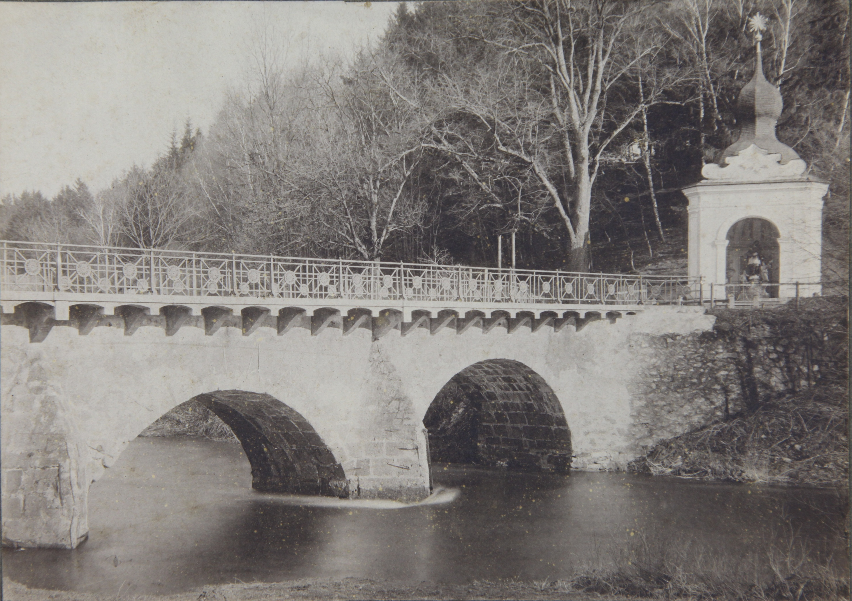

Slide 5
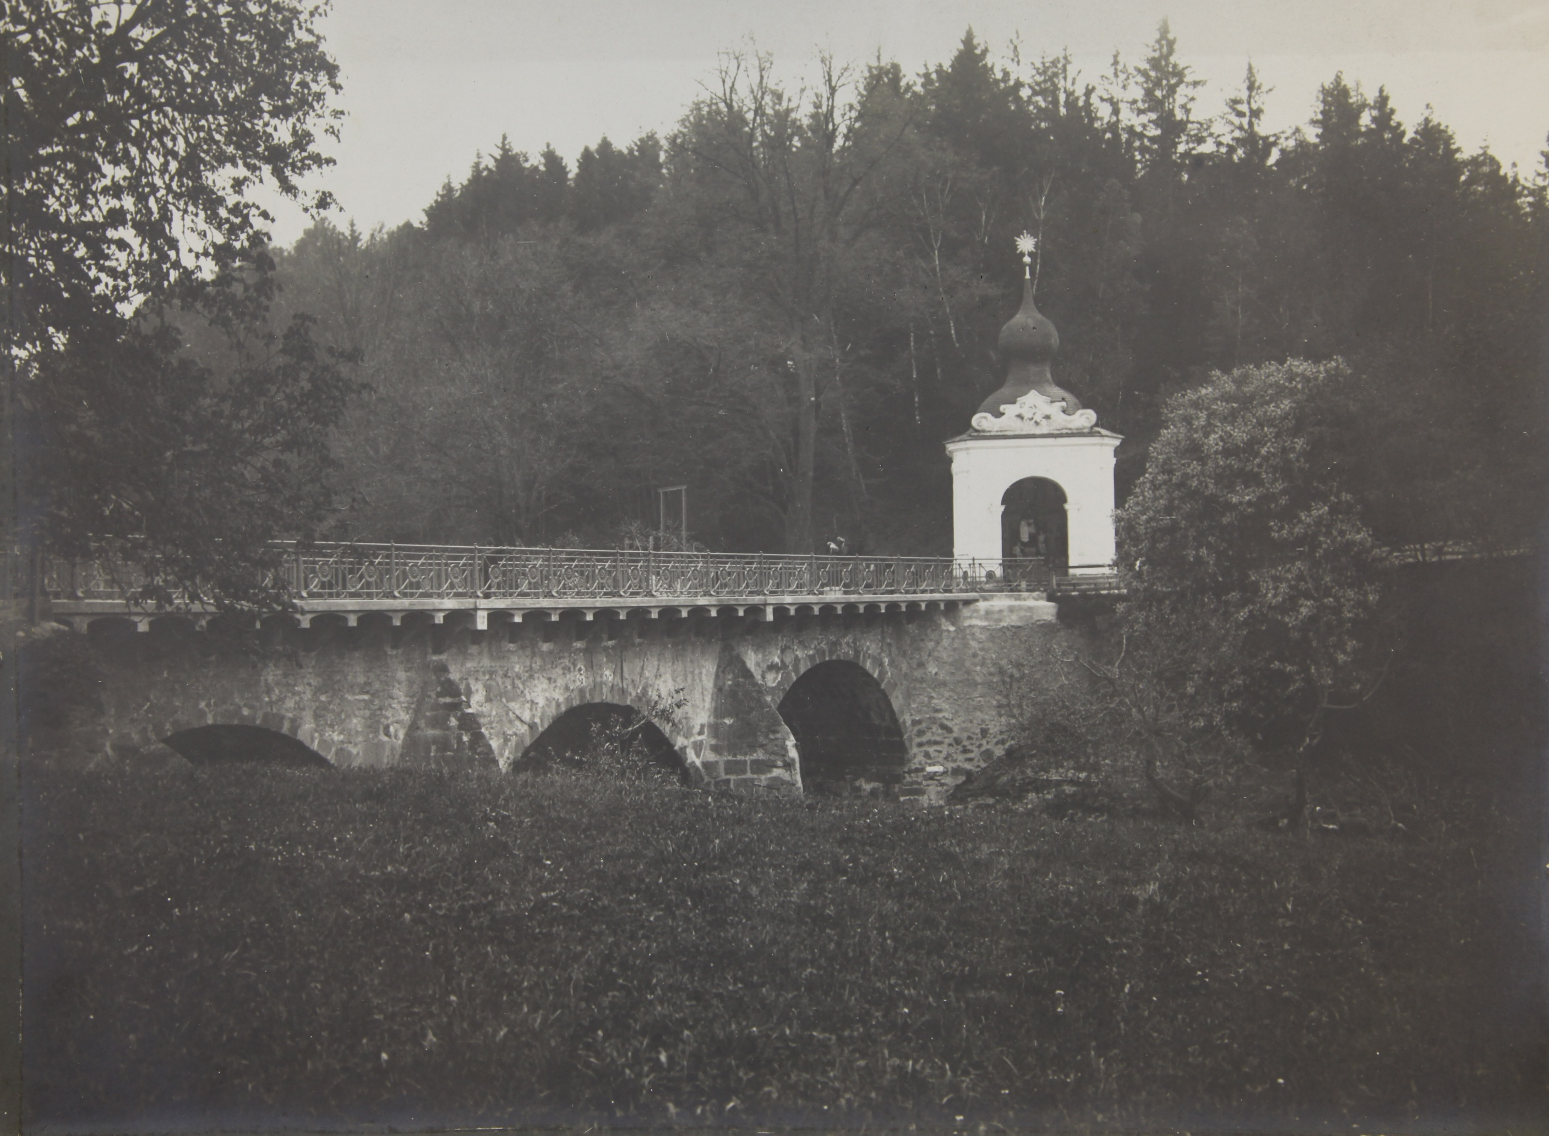

Slide 6
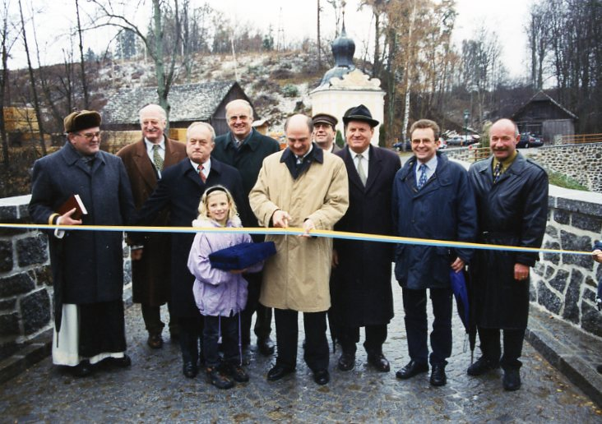
Completion of dismantling (?) of the Romanesque bridge
1997
StAZ BA-01-undatiert-323

